Slide 1
Robot Framework

Slide 2

Overview
Easy-to-use syntax
Nice reports and logs
Easy to include custom python libraries
Provides lots of useful keywords
Provides tagging
Provides tools for integration with other infrastructure (e.g. TMS)

Slide 3
Installation
pip install robotframework==3.1.1
robot --version
Robot Framework 3.1.1
Success :)
Intellibot – pycharm plugin for RobotFramework

Slide 4
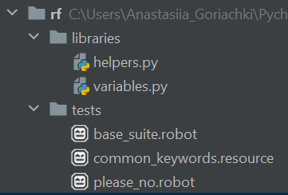
Structure
Base “project” structure:
Test suites and resource file
Python modules
robot [options] tests
python –m robot [options] tests
robot [options] tests/base_suite.robot

Slide 5
Test Creation
Test data sections
Settings | 1) Importing test libraries, resource files and variable files. 2) Defining metadata for test suites and test cases.
Variables | Defining variables that can be used elsewhere in the test data.
Test Cases | Creating test cases from available keywords.
Tasks | Creating tasks using available keywords. Single file can only contain either tests or tasks.
Keywords | Creating user keywords from existing lower-level keywords
Comments | Additional comments or data. Ignored by Robot Framework.

Slide 6
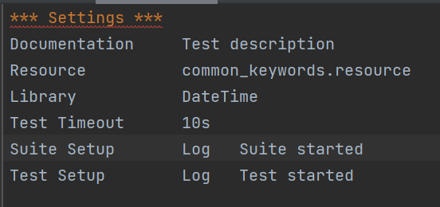
Settings section example
--pythonpath path/to/lib – to avoid specifying the path to custom python library explicitly in Library subsection

Slide 7
Settings Section
Library | Used for importing libraries
Resource | Used for taking resource files into use.
Variables | Used for taking variable files into use.
Documentation | Used for specifying a test suite or resource documentation.
Metadata | Used for setting free test suite metadata.
Suite Setup | Used for specifying the suite setup.
Suite Teardown | Used for specifying the suite teardown.
Test Tags | Used for specifying test case tags for all tests in a suite.
Force Tags, Default Tags | Deprecated settings for specifying test case tags.
Keyword Tags | User for specifying user keyword tags for all keywords in a certain file.
Test Setup | Used for specifying a default test setup.
Test Teardown | Used for specifying a default test teardown.
Test Template | Used for specifying a default template keyword for test cases.
Test Timeout | Used for specifying a default test case timeout.
Task Setup, Task Teardown, Task Template, Task Timeout | Aliases for Test Setup, Test Teardown, Test Template and Test Timeout, respectively, that can be used when creating tasks.

Slide 8
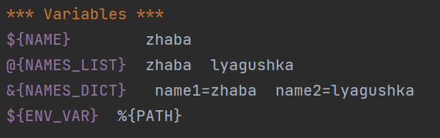
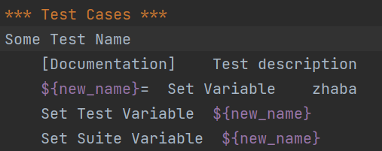
Variables
Variables types
Variables from command line
Variable section in a test case file
Imported resource and variable files
Variables set during test execution
Built-in variables (e.g. ${TEST_NAME})
Variables scopes
Global scope
Test suite scope
Test case scope
Local scope

Slide 9
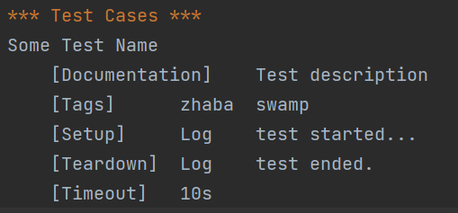
Test case settings

Slide 10
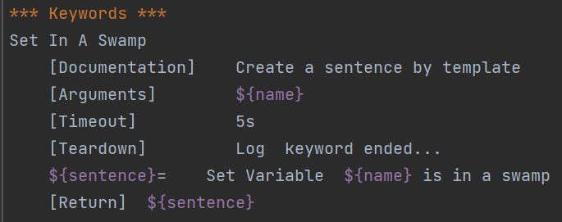
Keywords

Slide 11
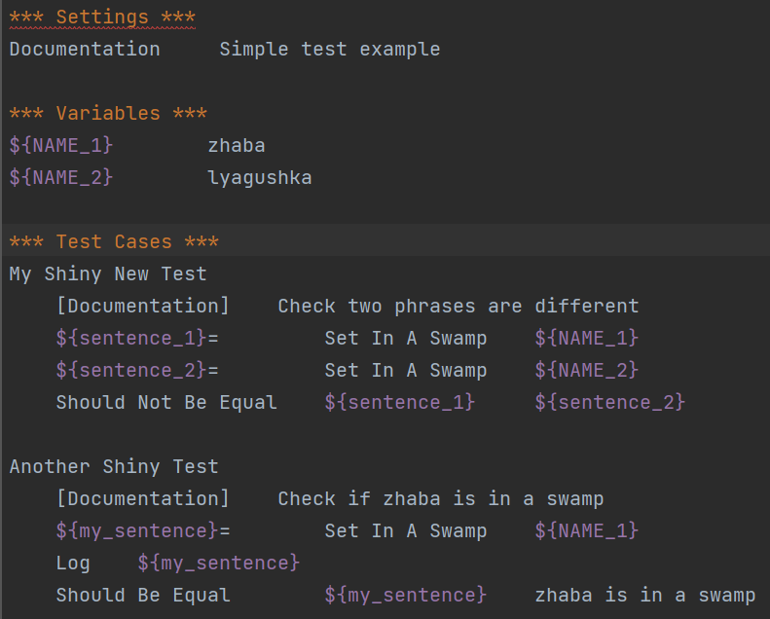
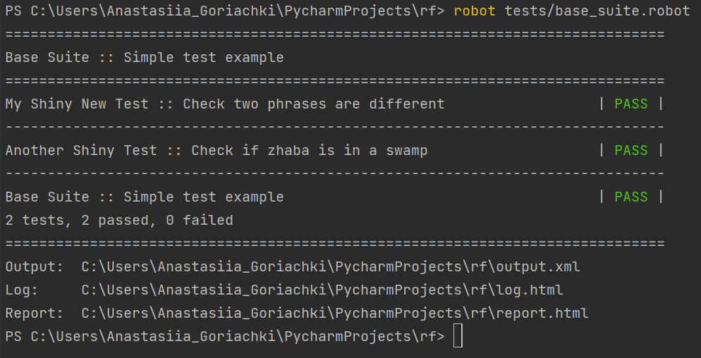

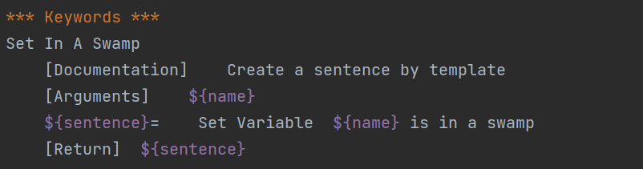
First Test case
--outputdir path/to/output
output.xml - contains all the test execution results in xml format
log.html - contains details about the executed test cases in HTML format
report.html - contains an overview of the test execution results
in HTML format
Zhaba was here

Slide 12
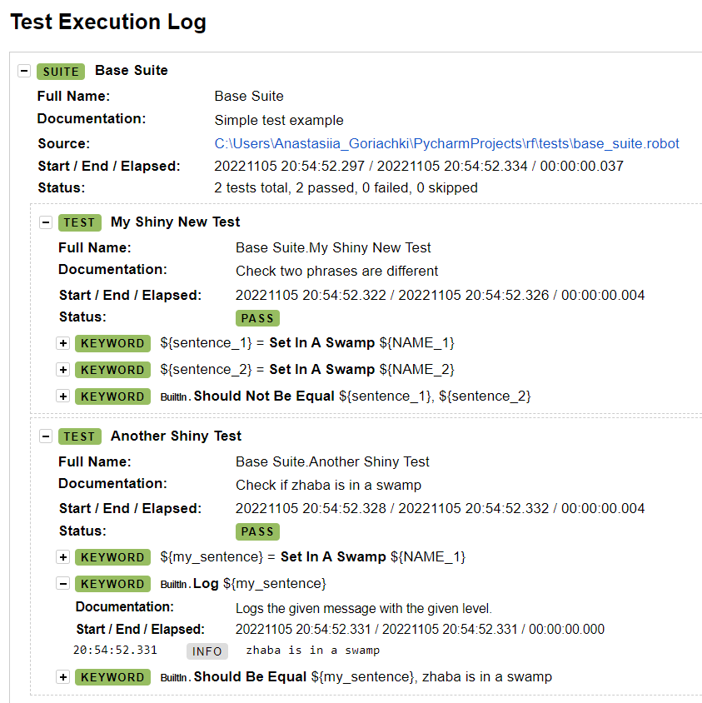
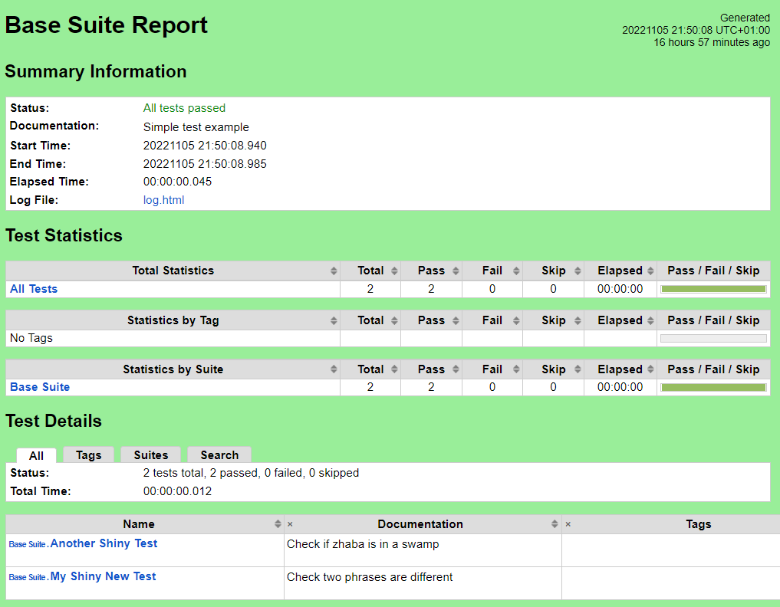
Log and report example
10

Slide 13
Good tests
All the names should be as descriptive and clear as possible
Use an existing keyword if possible
Do not forget about documentation
Tests in suite should be related to each other
Tests should be independent
One test case should test one thing
Try to avoid too long suites and resource files
Try to avoid writing complex logic via RobotFramework (use Python :)

Slide 14
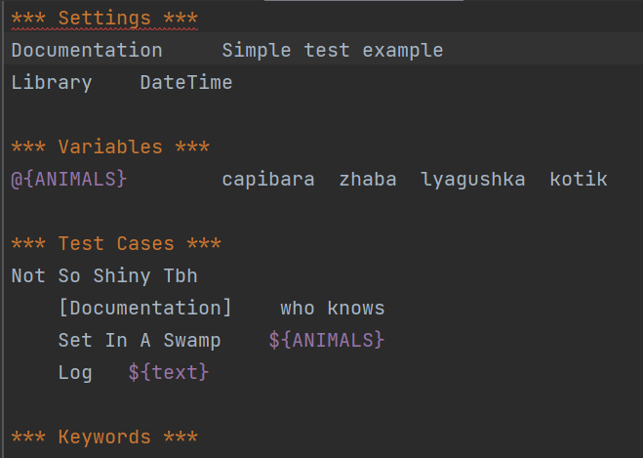
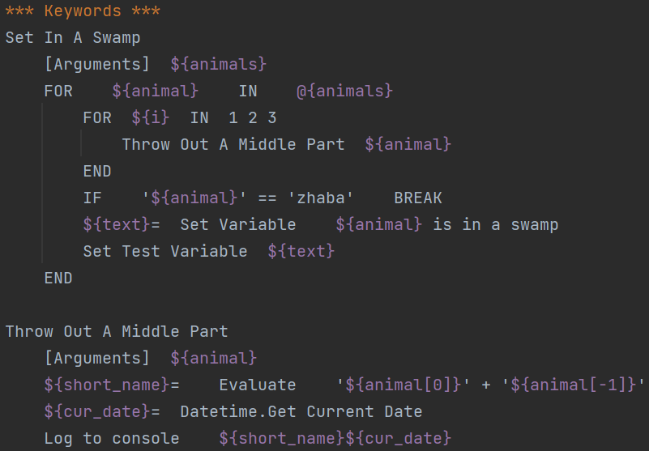
Please no :(

Slide 15
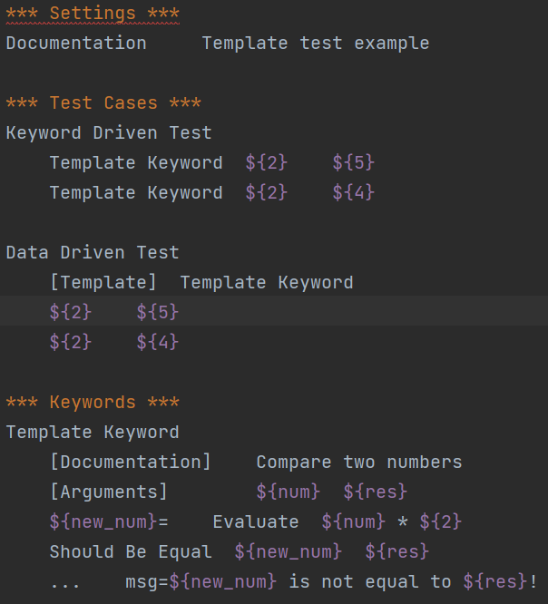
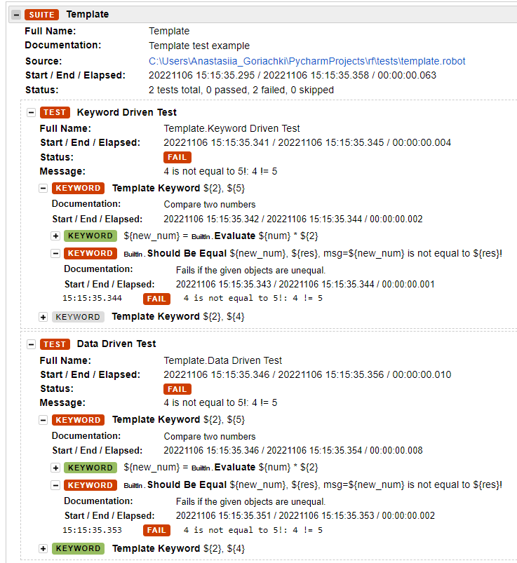
Templates
(data-driven style)

Slide 16
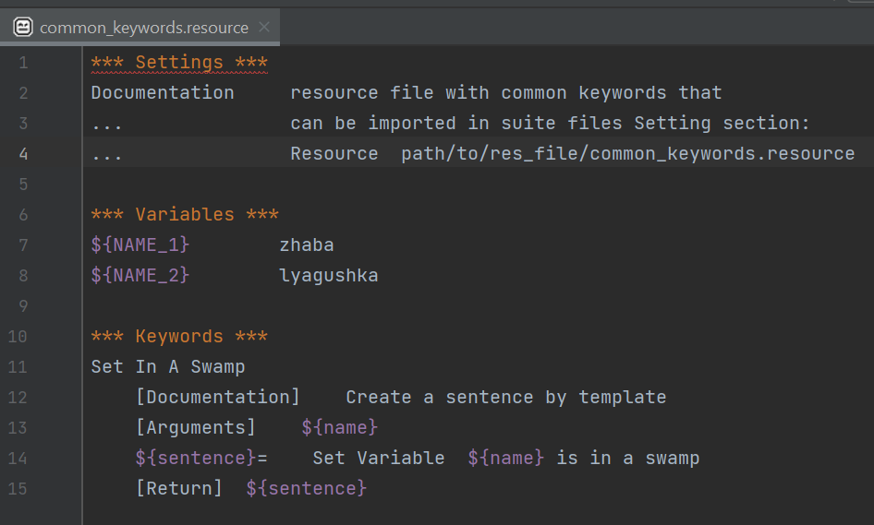
Resource files

Slide 17
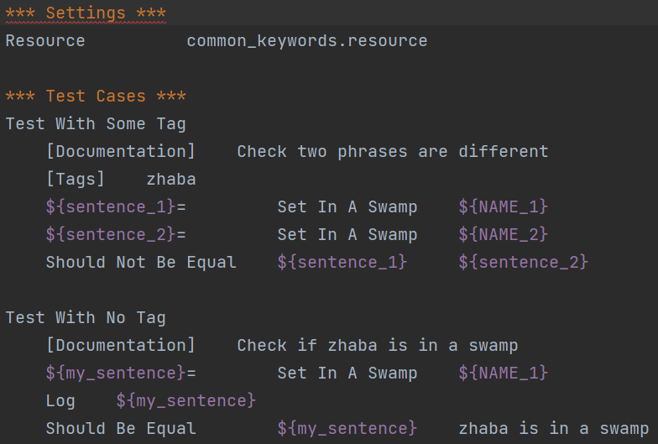
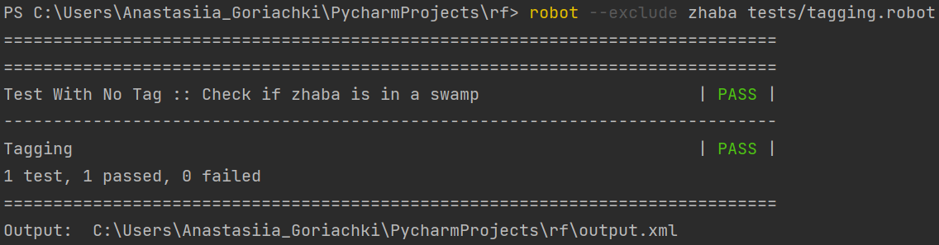
Tags
how to specify tags?
Test Tags in the Setting section
[Tags] with each test case
--settag command line option
Set Tags, Remove Tags keywords
<- example

Slide 18
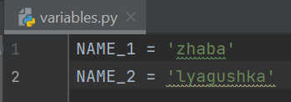
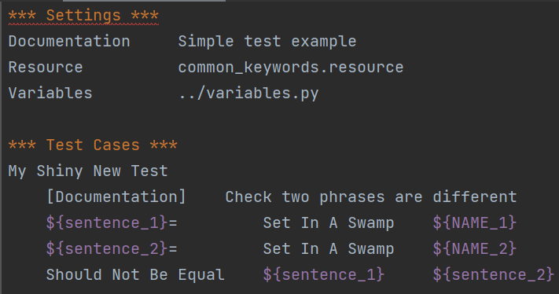
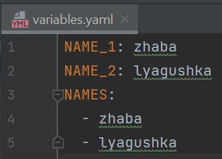
Variable files
Using Python files:
Using YAML files
(example)

Slide 19
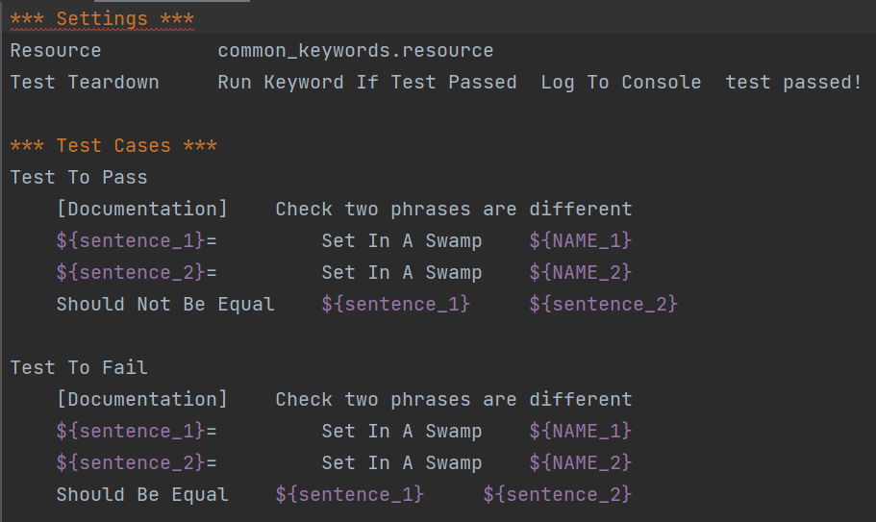
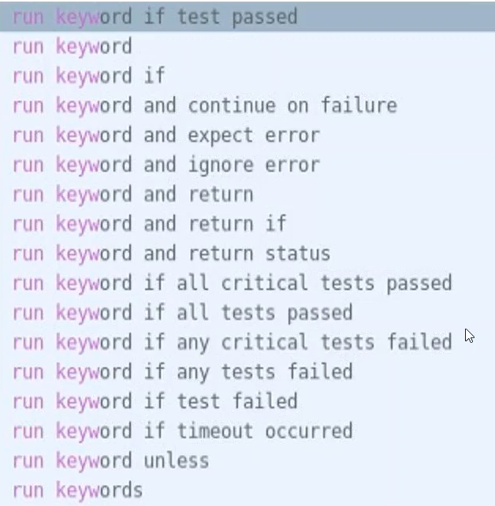
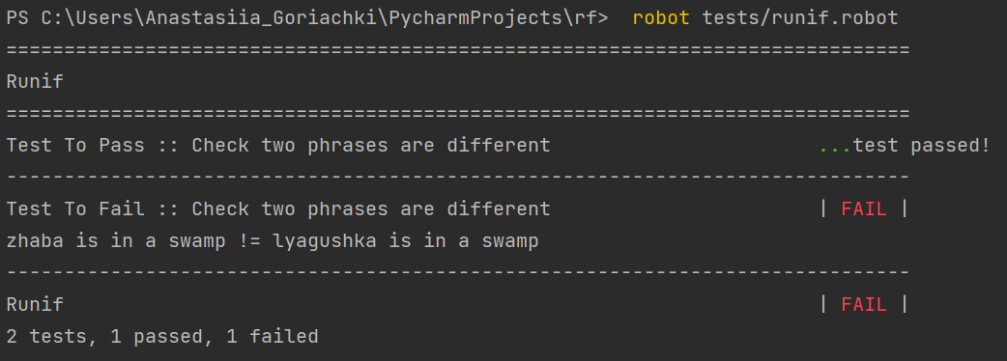
Conditional execution

Slide 20
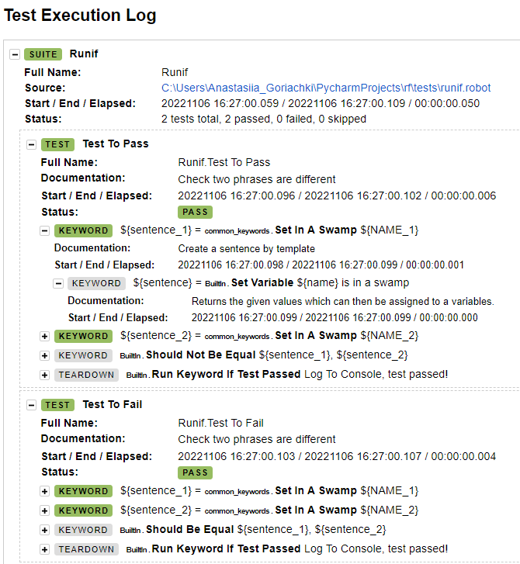
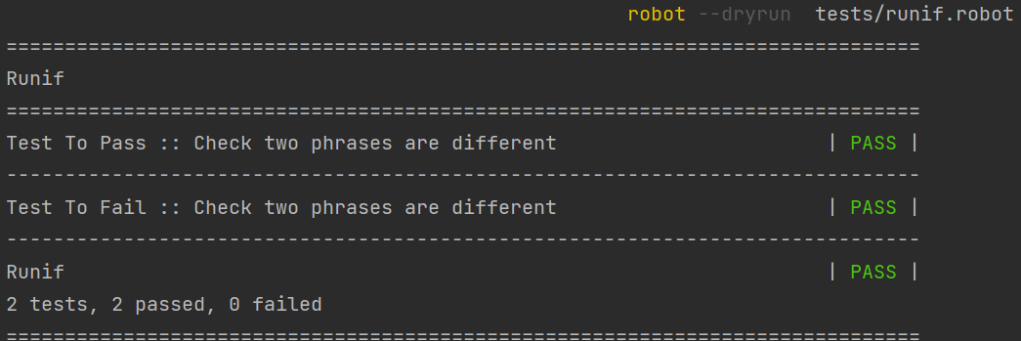
Dry-run
In dry-run mode the keywords coming from the test libraries
are not executed at all
The dry run execution may fail for following reasons:
Using keywords that are not found.
Using keywords with wrong number of arguments.
Using user keywords that have invalid syntax.

Slide 21
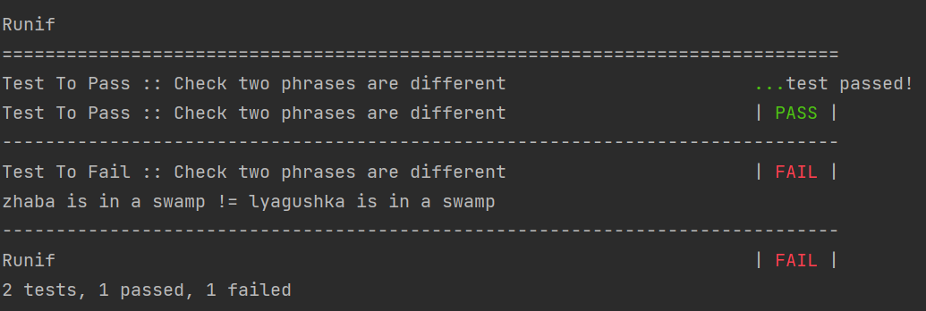
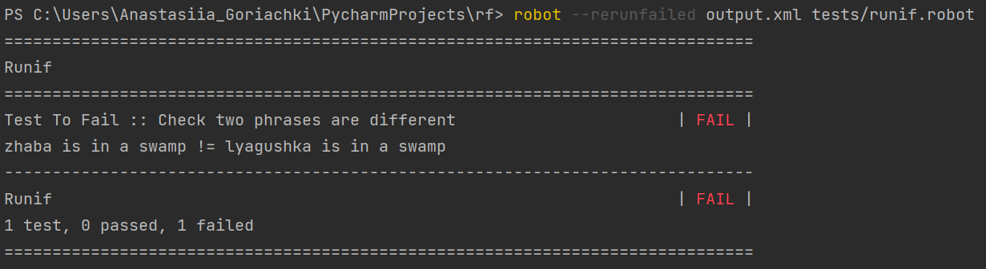
Rerun failed test cases
--rerunfailed option
uses existing output.xml file!

Slide 22
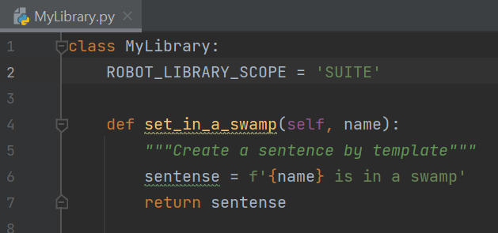
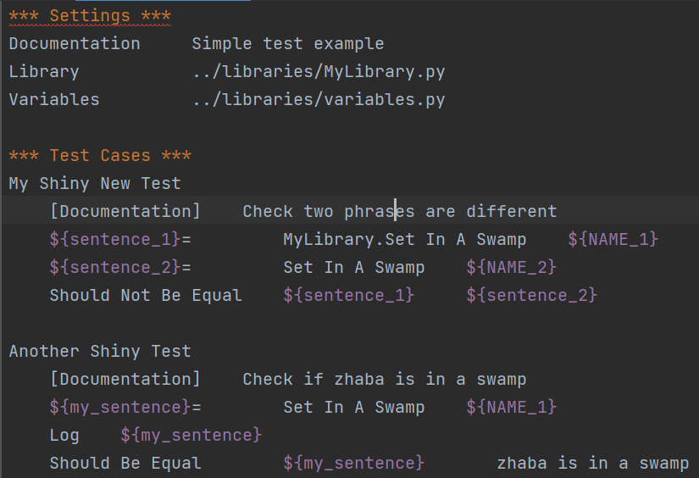
Extending Robot framework
ROBOT LIBRARY SCOPE:
TEST
SUITE
GLOBAL
New instance is created every test/suite/whole test execution

Slide 23
Listeners
Listeners allow us to do sth during test execution (e.g. reporting test results to TMS)
robot --listener path/to/MyListener.py tests.robot
Listener is a class with following methods:
start_suite(name, attributes)
start_test(name, attributes)
end_suite(name, attributes)
end_test(name, attributes)
start_keyword(name, attributes)
end_keyword(name, attributes)
close
…
and contains ROBOT_LISTENER_API_VERSION variable
2 version listener methods can do sth with the information they receive, but they cannot directly change it. If that is needed, listener version 3 can be used instead.

Slide 24
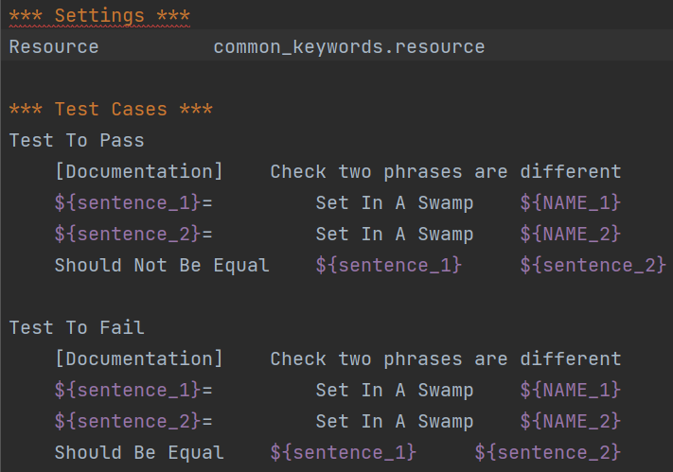
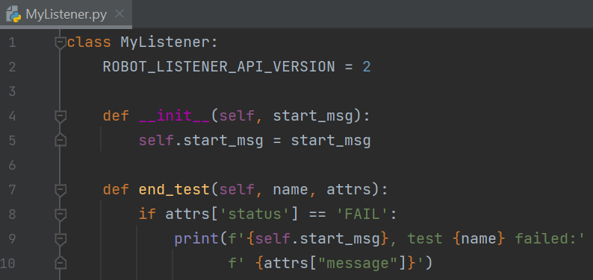
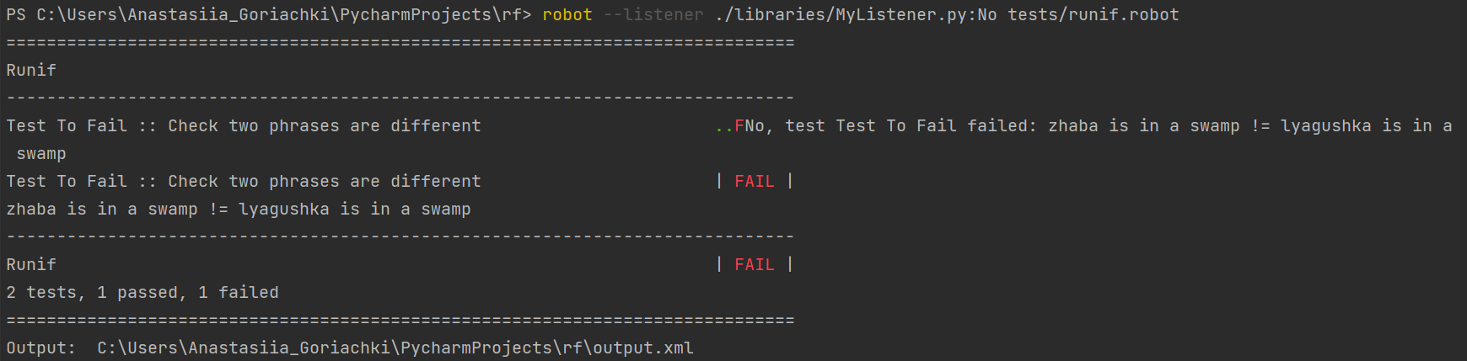
Listeners Example

Slide 25
Parallelization
Pabot
pip install robotframework-pabot
> pabot --processes proc_num path/to/test_suites
../valueset.dat
[Server1]
tags=admin-server
HOST=123.123.123.123
USERNAME=user1
[Server2]
tags=server
HOST=121.121.121.121
USERNAME=user2
[Server3]
tags=admin-server
HOST=222.222.222.222
USERNAME=user3
Pay attention to shared resource usage!
../test.robot
*** Test Case ***
Test Case Name
${valuesetname}= Acquire Value Set admin-server
${host}= Get Value From Set host
Log Do something with the values
Release Value Set
>pabot --pabotlib --resourcefile valueset.dat test.robot

Slide 26
THE END :)

